Slide 1

Customer Churn Analysis in E-commerce
Presented by Prokopenko Maksim | Developer Institute | 11 of August 2025

Slide 2



The Challenge: Stopping Your Customers for Leaving.
Customer churn is a critical issue for e-commerce businesses, directly impacting revenue and growth. Identifying and understanding why customers leave is the first step toward building effective retention strategies.
Lost Revenue
Churn directly reduces sales and future lifetime value.
Stunted Growth
High churn rate undermines expansion efforts.

Slide 3

Dataset Snapshot: Unveiling Customer Behavior
To do this, we used information about 5,600 customers. This rich data source allowed us to examine various aspects of customer interaction and transactional history.
Source
Churn E-commerce Analysis Dataset from Kaggle
Size
5,600+ records, 20 features
Key Features
Tenure, CityTier, Gender, Satisfaction Score, Number of Complaints, Purchase Frequency, Last Purchase Value
Observed Churn Rate
16.84%

Slide 4
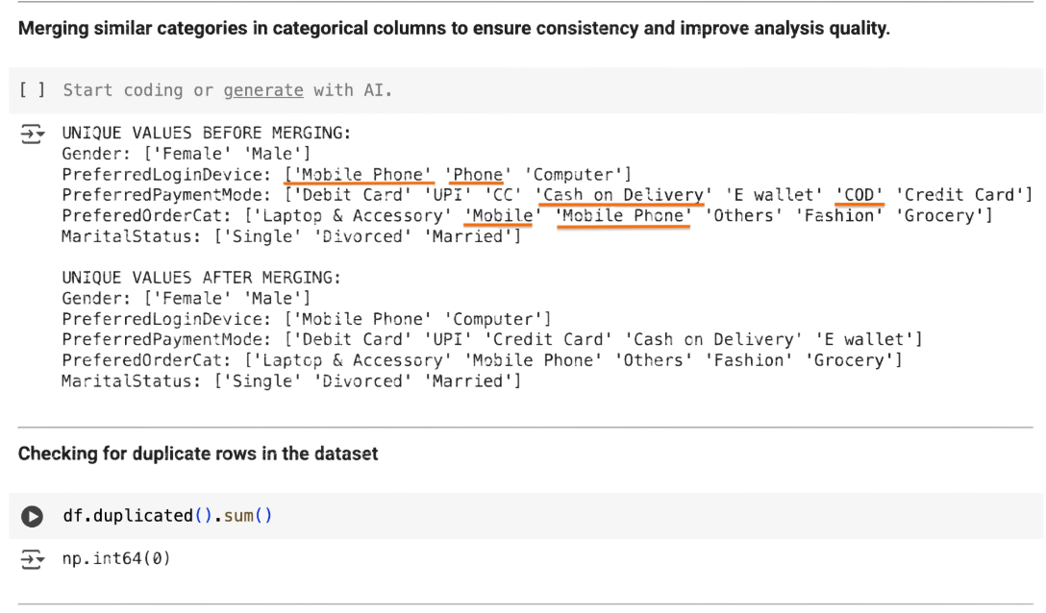
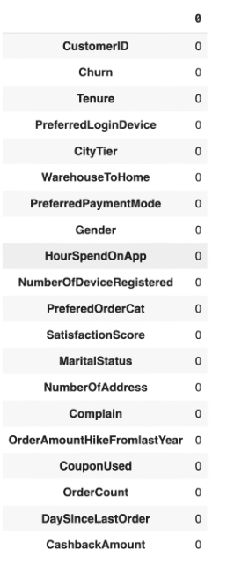
Data Preparation: Laying the Foundation
Preparing data well is very important for predicting churn accurately. This phase involved cleaning the data carefully, handling missing values, and changing the data into a format that can be used in a model.
Data Cleaning
Identified and corrected inconsistencies, removed duplicate entries.
Missing Value Imputation
Strategically addressed missing data using appropriate imputation techniques (mean).

Slide 5


Feature Engineering: Enriching the Data Landscape
Engineered features from existing data helped capture customer behavior and improve model performance.
Tenure Group
RFM Score
Categorized customer longevity (New, Stable, Recent,Loyal) to better reflect retention phases.
Calculated Recency, Frequency, and Monetary value for each customer, a powerful indicator of engagement.
For example, RFM scores helped differentiate high-value, active customers from those who might be lapsing, providing a clearer signal for churn prediction than individual purchase metrics alone.

Slide 6
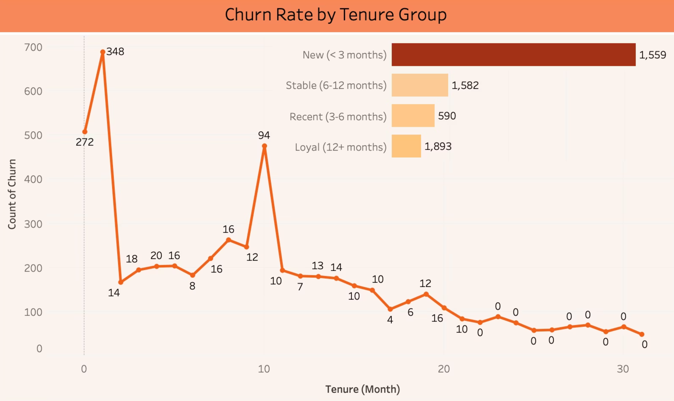
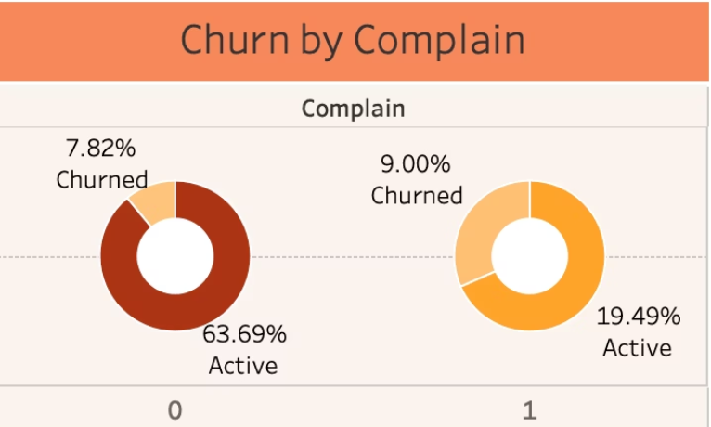
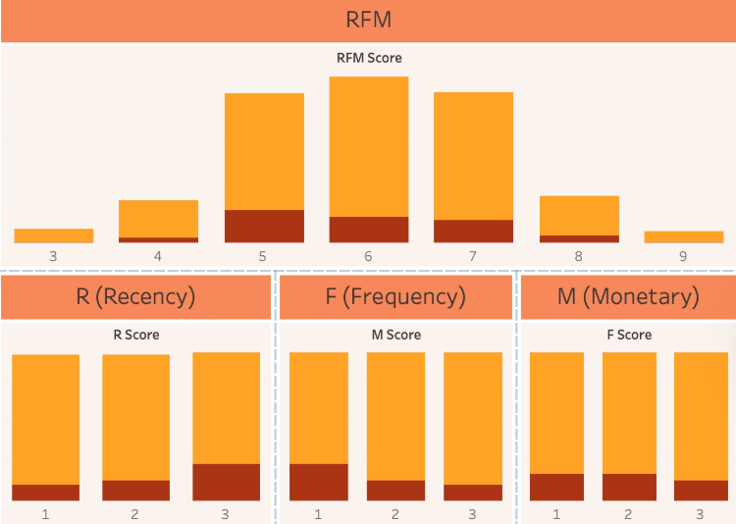
Exploratory Data Analysis (EDA) / Insights
Exploratory data analysis revealed compelling patterns and surprising insights into customer churn. Visualizations helped us identify strong correlations and behavior specific to each segment.
Most churn happens within the first 3 months: Over 1,500 customers churned in the "New" group (<3 months). As tenure increases, churn drops sharply — "Loyal" customers (12+ months) rarely leave.
Customers who made a complaint churn more often:
Churn is highest for mid-level RFM scores (5–7):
Among customers who complained, the churn rate is 9% vs. 7.8% for those who did not complain.
These customers are neither the newest nor the most loyal, but are at risk.

Slide 7
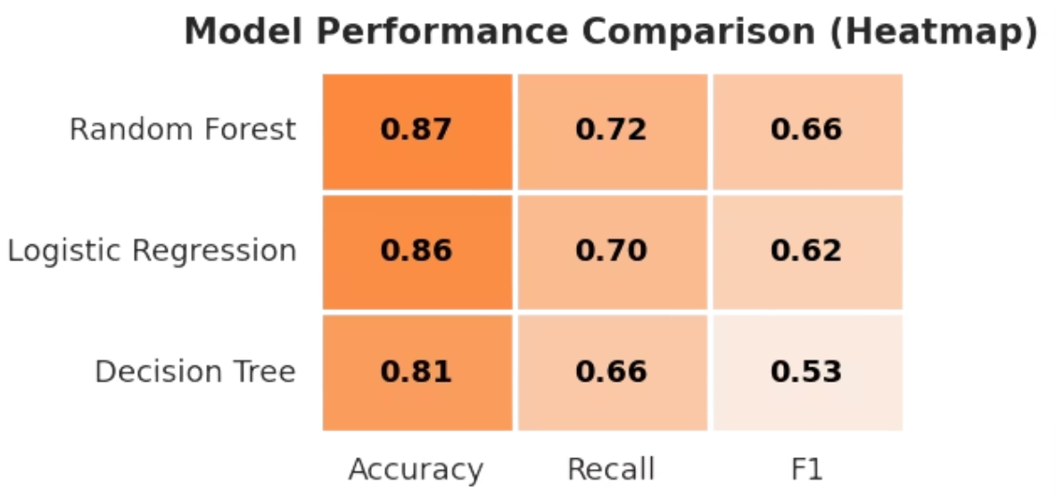
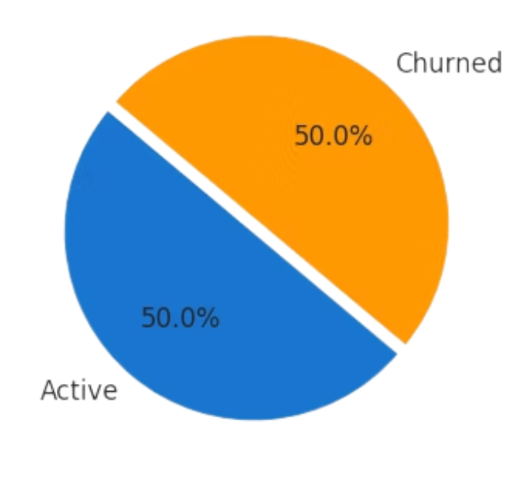
Model Performance / Comparison
1
Random Forest achieved highest accuracy and recall, making it the top performer.
2
Logistic Regression was a strong baseline.
3
Decision Tree performed worst .
Class distribution (after SMOOTH)
Class imbalance addressed using SMOTE.
Balanced classes enabled fairer model training and improved recall.

Slide 8
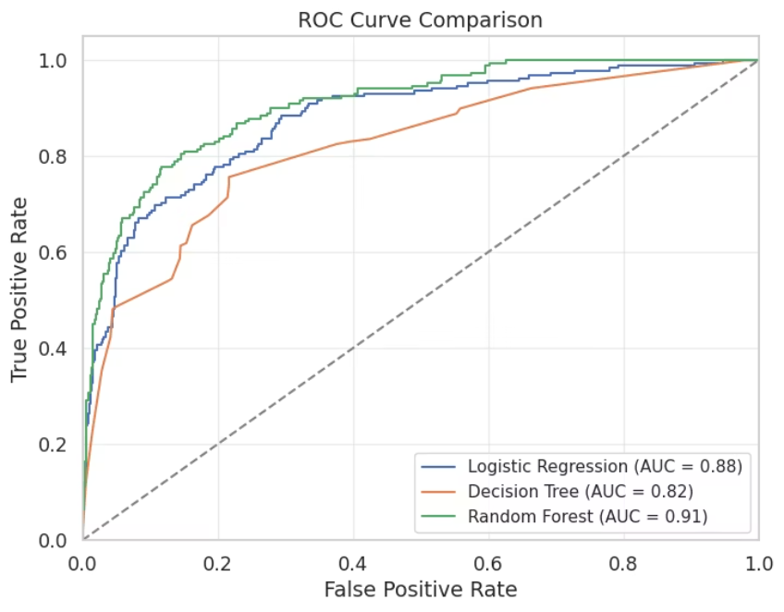
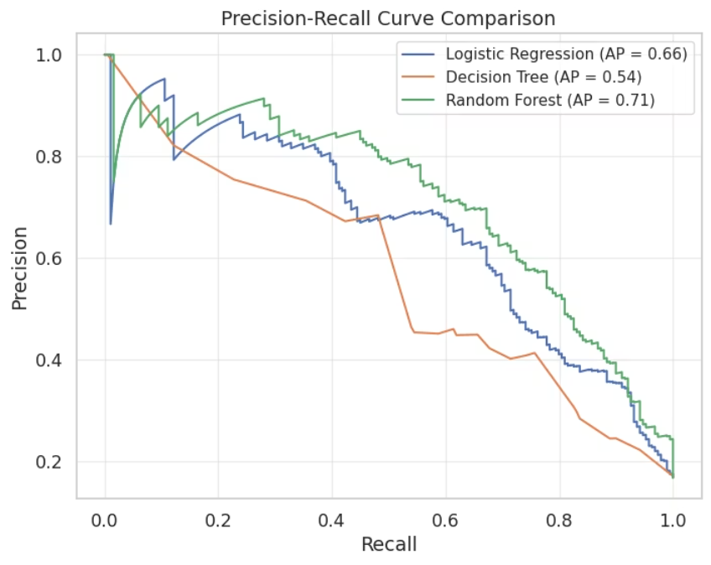
Advanced Model Evaluation: ROC / Precision-Recall Curves
ROC Curve: Measures how well the model distinguishes churned from active customers. Higher AUC = better performance.
Precision-Recall Curve: Shows the balance between identifying churned customers (recall) and prediction accuracy (precision).
Model
AUC
AP
Random Forest
0.91
0.71
Logistic Regression
0.88
0.66
Decision Tree
0.82
0.54
The higher the AUC and Precision-Recall scores, the better the model is at finding customers who will churn.
Random Forest was the most reliable model on both metrics – you can trust its predictions the most.
AUC shows how well the model separates churned customers from active ones.
Average Precision shows how completely and accurately the model finds all churned customers.

Slide 9
Insights / Recommendations: Driving Actionable Change
Our analysis provides concrete, data-driven recommendations to mitigate churn and enhance customer lifetime value.
Target Early Engagement
Prioritize Satisfaction
Leverage RFM Segmentation
Focus on new customers during their first six months with individualized retention strategies.
Actively monitor and address customer satisfaction scores. Implement feedback loops and proactive support for low-scoring segments. Consider post-purchase surveys on key touchpoints.
Tailor re-engagement campaigns based on RFM scores. High-recency, low-frequency customers might need nudges to return, while high-value, low-monetary customers could be targeted with premium offers.
Increase early engagement and reduce churn by offering welcome bonuses, proactive customer support, and exclusive offers.

Slide 10
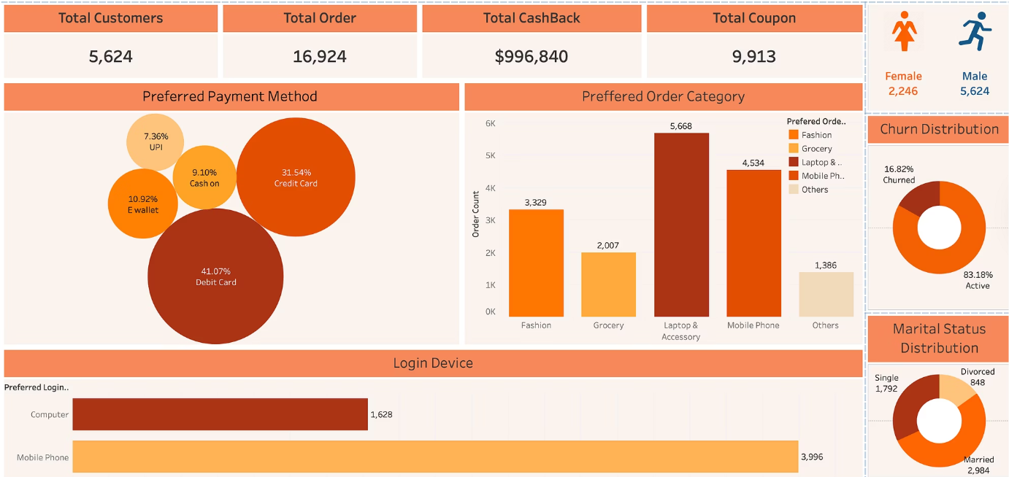
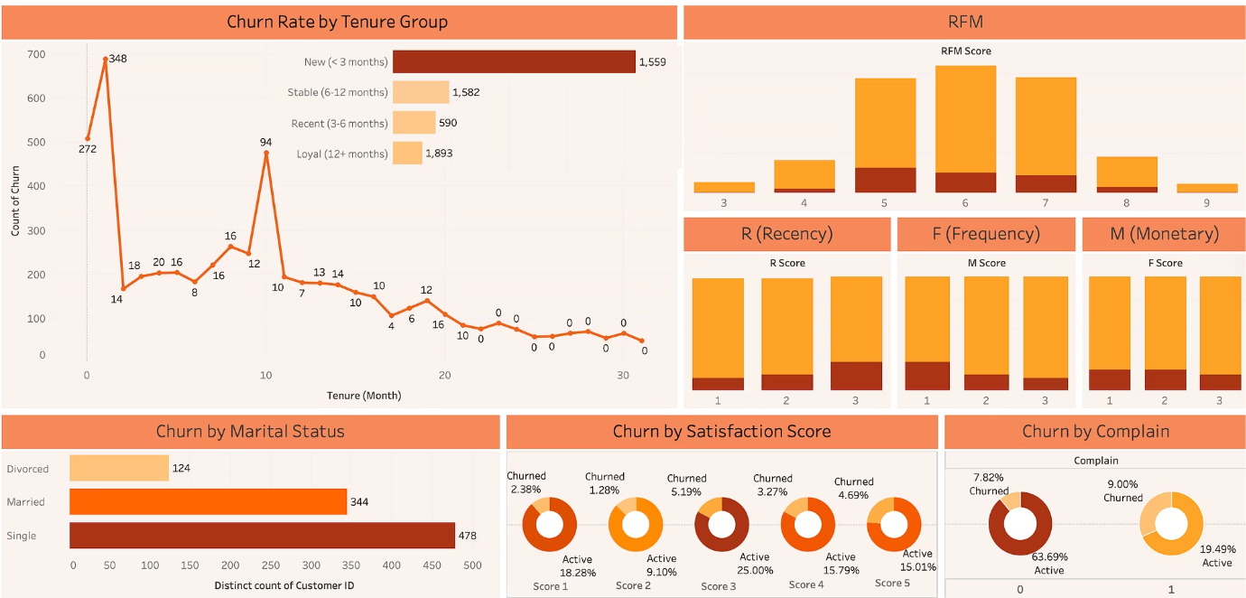
Interactive Dashboard
The insights from this analysis are integrated into an interactive Tableau dashboard, allowing business users to explore churn patterns, segment customers, and track retention initiatives in real-time.
Churn Analysis
Thank you for your attention! Ready for questions.

